Slide 1
Rhetorical Mirrors
Systemic Indignities in Marginalized Communities
Kyllikki Rytov, PhD
Northern Kentucky University
RSA 2026 Portland

Slide 2
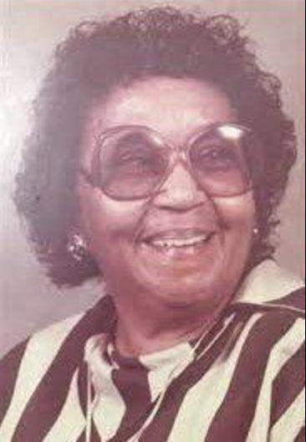
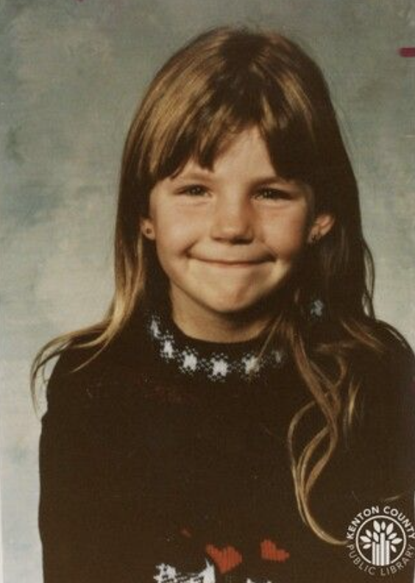
Ruthie Mae McCoy (d. 1987)
Jenny Sue Iles (d. 1989)

Slide 3
“In the context of violence against women, this elision of difference in identity politics is problematic, fundamentally because the violence that many women experience is often shaped by other dimensions of their identities, such as race and class.”
Kimberlé Crenshaw, “Mapping the Margins: Intersectionality, Identity Politics, and Violence against Women of Color” (1991)

Slide 4
Guiding Research Questions
(unanswered)
01
What does it mean when the state’s failure to protect becomes, afterward, a failure to remember?
02
How does institutional neglect become a second injury to victims, families, and communities?
03
How do class, race, gender, and perceived respectability shape whose suffering becomes legible as injustice?
04
What forms of rhetorical indignity emerge when families must preserve the memory of crimes that institutions have allowed to decay?

Slide 5
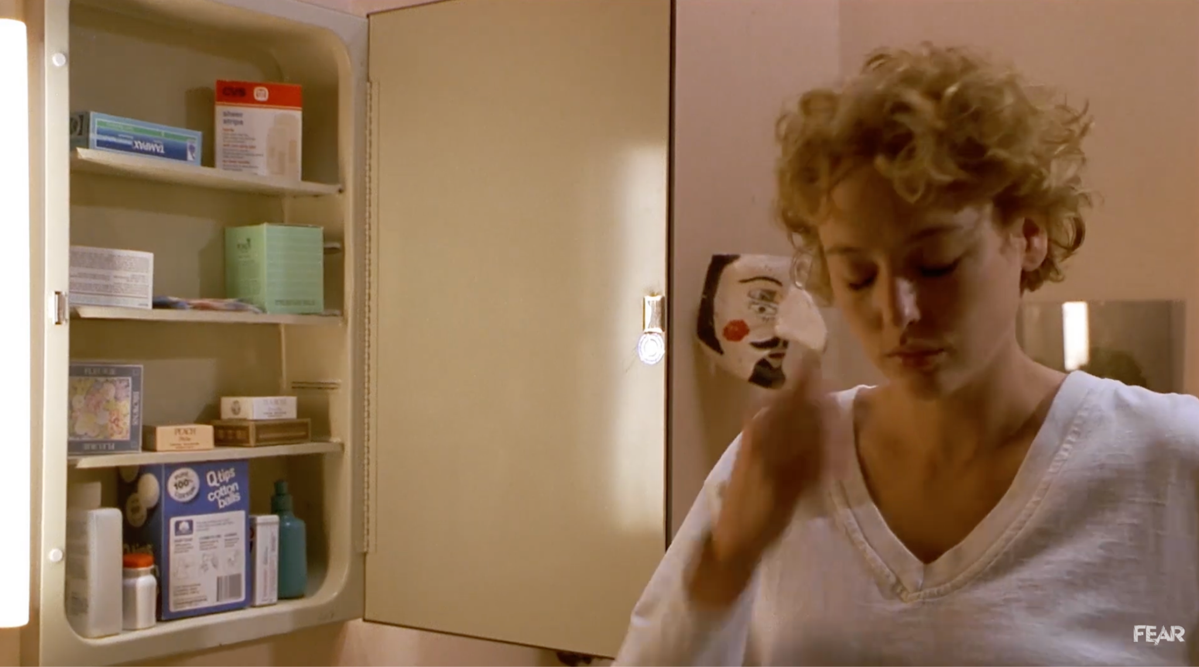
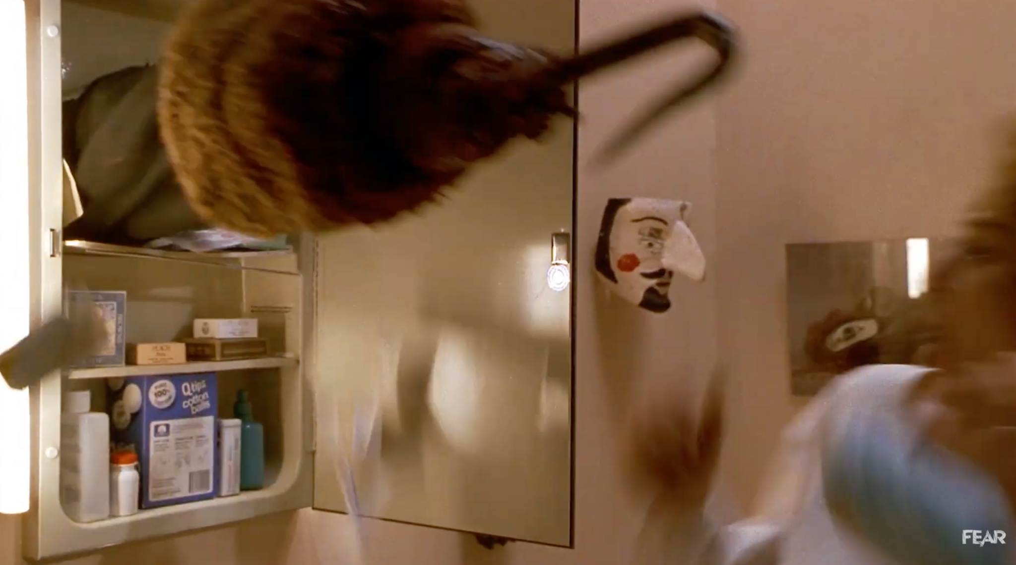
Candyman (1992)

Slide 6
In 1986, between seven and thirty complaints were reported to the Chicago Housing Authority: one woman, watching tv with a friend, reported that they were startled when a teenager burst out of her bathroom and ran out her front door; when the women went to investigate, a second, “heftier” teen was found stuck in the pipe chase.

Slide 7
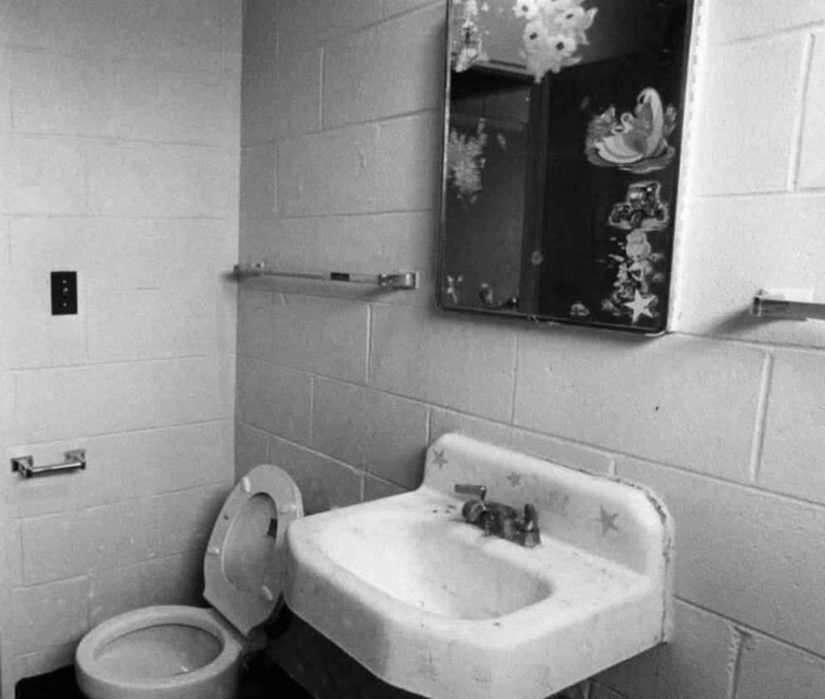
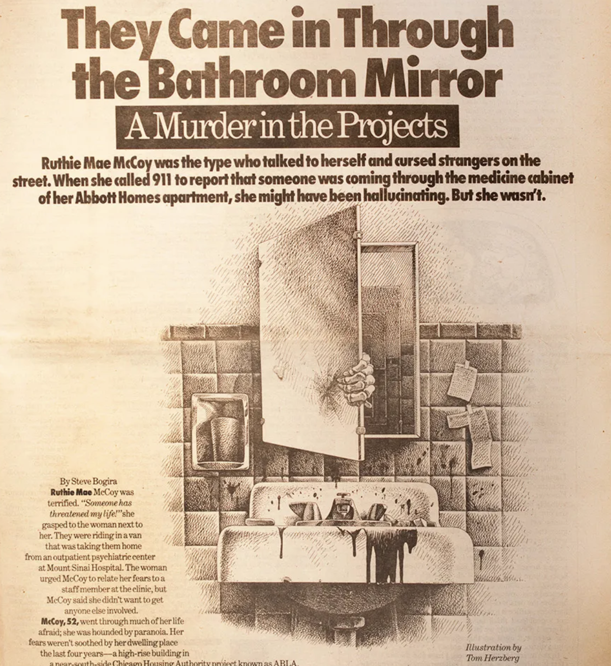

Slide 8
“Do you mean the ‘good’ Iles or the ‘bad’ Iles?”

Slide 9
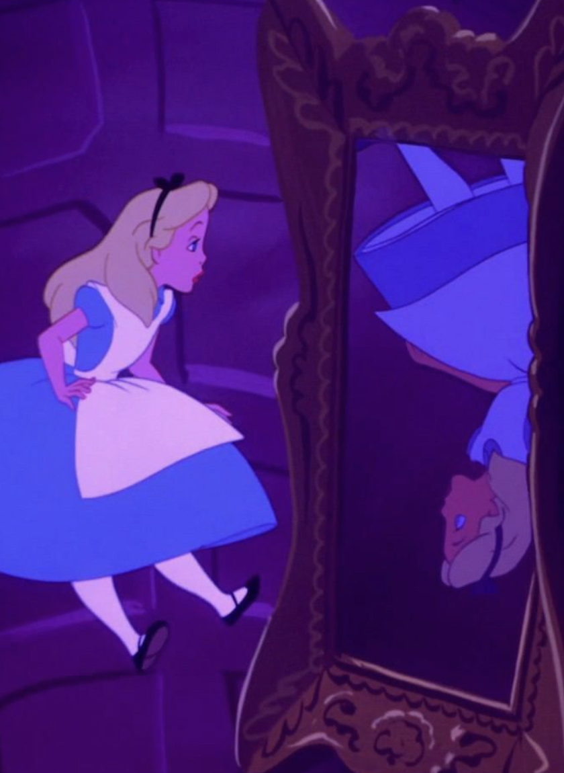
Disney’s Alice in Wonderland (1951)

